Slide 1



Reinforcement Learning: Supervised Learning Project
Pragyesh Gupta
Under the guidance of Proff Asim Tewari

Slide 2
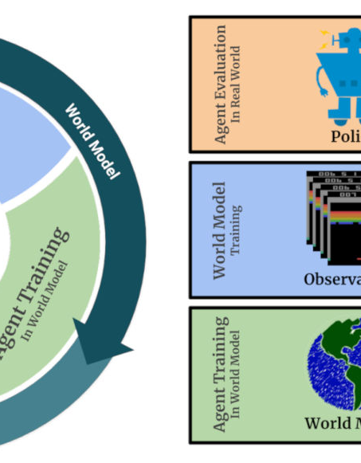
Introduction
"Reinforcement Learning is a type of machine learning where an agent learns by interacting with an environment, making decisions, and receiving feedback in the form of rewards or penalties."
"The fundamental idea behind RL is learning through trial and error, aiming to maximize cumulative reward over time."
This Photo by Unknown author is licensed under CC BY-SA.

Slide 3

Key Components of RL
Agent: "The entity that learns and makes decisions within the environment."
Environment: "The external system with which the agent interacts."
State: "A representation of the current situation or configuration of the environment."
Action: "The set of possible moves or decisions the agent can make."
Reward: "A numerical feedback signal indicating the immediate benefit or cost of an action."

Slide 4

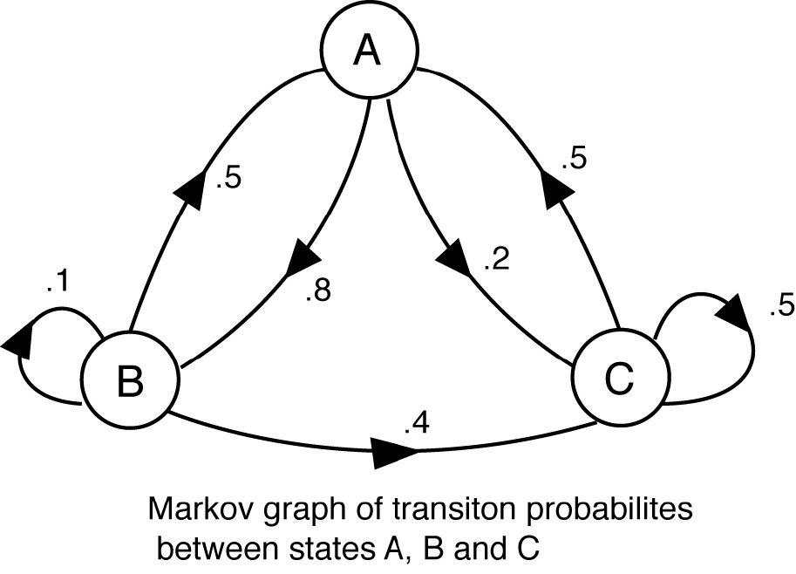
Markov Decision Processes
Formal Framework: "MDPs provide a formal framework to model RL problems, defining the set of states, actions, transitions, and rewards."
Markov Property: "The Markov property states that the future state depends only on the current state and action, making it memoryless."

Slide 5
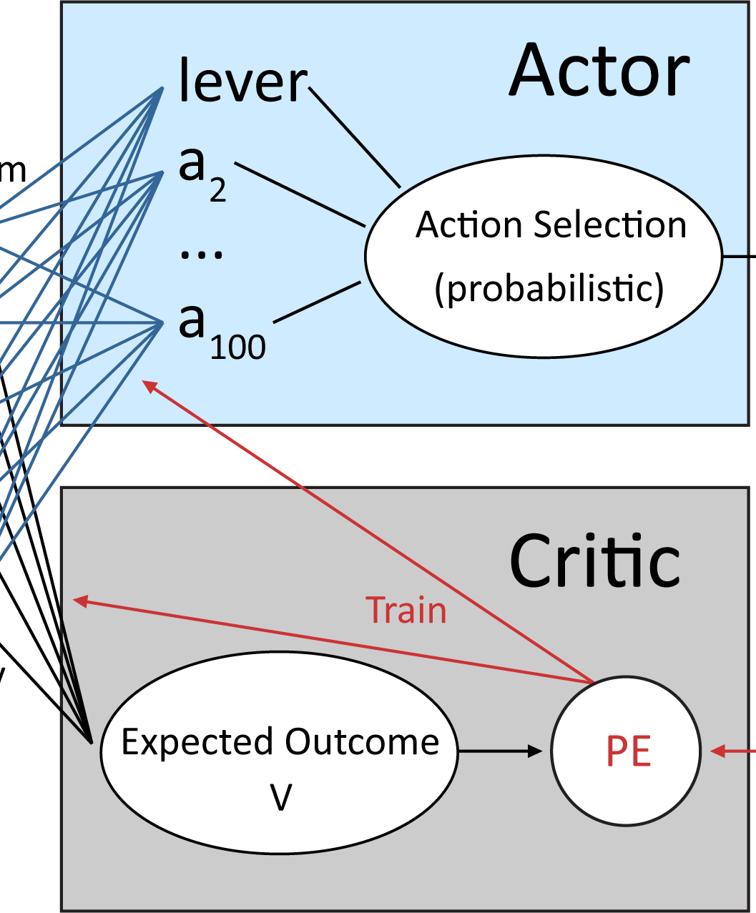
Policy Search
"A policy is a strategy or mapping from states to actions, representing the agent's decision-making process."
Policy Search: "Policy Search involves finding the best policy that guides the agent to maximize cumulative rewards."

Slide 6
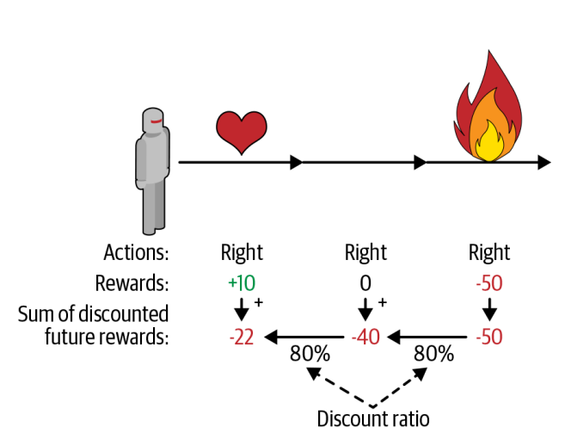
Credit Assignment Problem
Challenge: "Credit Assignment is the problem of attributing outcomes to the actions that led to those outcomes, essential for learning from experience."
"Effective credit assignment is critical for the agent to understand which actions contribute to positive or negative outcomes."

Slide 7
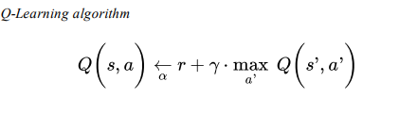
Q-Learning
Model-Free Algorithm: "Q-Learning is a model-free RL algorithm that learns the quality of actions in a given state."
Update Rule: "The Q-value is updated iteratively based on the reward received and the estimate of the optimal future value."

Slide 8
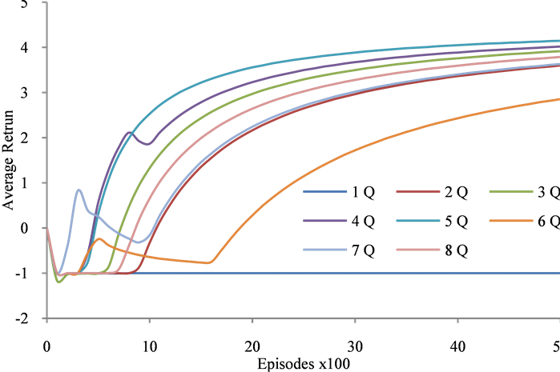
Deep Q Learning
"Deep Q Learning extends traditional Q-Learning by incorporating deep neural networks to handle high-dimensional state spaces."
"DQN addresses limitations of Q-Learning, allowing for more complex and realistic applications."
"Experience Replay is a technique used in DQN to store and randomly sample past experiences, improving stability and efficiency."

Slide 9
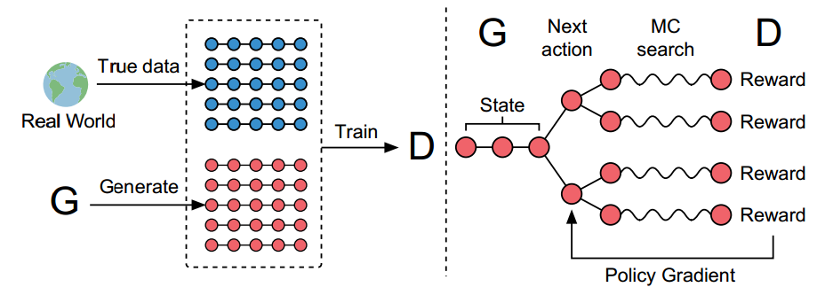
Slide 8: Policy Gradients
Policy-Based Methods: "Policy Gradients are a class of RL methods that directly learn a parameterized policy."
"Policy-based methods often offer advantages over value-based methods, especially in dealing with high-dimensional and continuous action spaces."

Slide 10
Popular Policies
"Deterministic policies directly map states to specific actions."
"Stochastic policies introduce randomness, providing a distribution over actions for a given state."
Exploration-Exploitation Tradeoff: "Balancing exploration and exploitation is crucial for effective learning in RL."

Slide 11
Challenges in RL
High Dimensionality: "Handling high-dimensional state and action spaces is a common challenge in RL."
01
"Finding the right balance between exploring new actions and exploiting known actions is a key challenge."
02
Credit Assignment: "Credit assignment becomes challenging in scenarios where delayed consequences are involved."
03

Slide 12
Applications of RL
Game Playing: "RL has achieved remarkable success in game playing, such as AlphaGo mastering the game of Go."
Robotics: "In robotics, RL enables machines to learn complex tasks through interaction with the environment."
Finance: "RL is applied in financial modeling and algorithmic trading for decision-making."
Healthcare: "In healthcare, RL is used for personalized treatment plans and drug discovery."

Slide 13
Practical Applications : CartPole
Introduction: "Let's explore a practical application of Reinforcement Learning using the CartPole environment."
CartPole Environment: "CartPole is a classic RL problem where an agent must balance a pole on a moving cart."
Objective: "The goal is to prevent the pole from falling by applying left or right forces to the cart."
State and Action Spaces: "The state space includes variables like cart position, cart velocity, pole angle, and pole angular velocity. Actions are binary: move left or move right."
RL Approach: "An RL agent learns a policy to balance the pole through interactions with the environment."

Slide 14


Practical Applications : CartPole
Before Training : Taking Random Samples
After Training : Using MLP policy in A2C

Slide 15
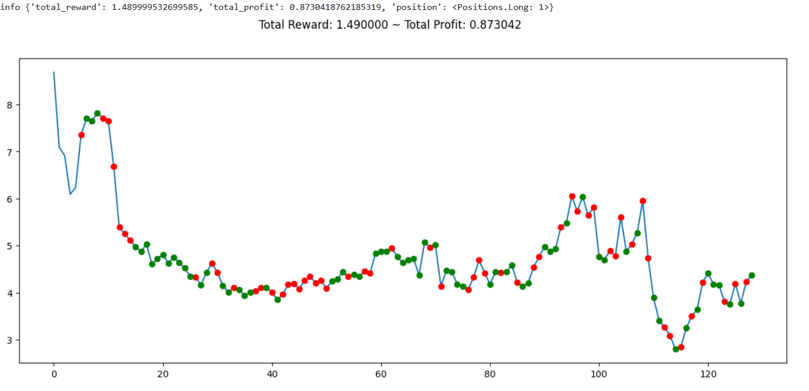
Practical Applications : Trading Bot

Slide 16
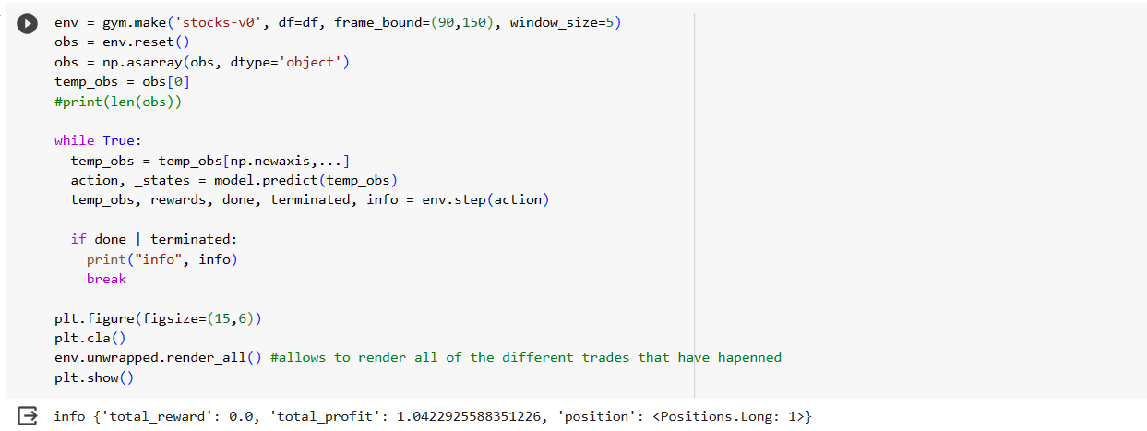
Practical Applications : Trading Bot

Slide 17
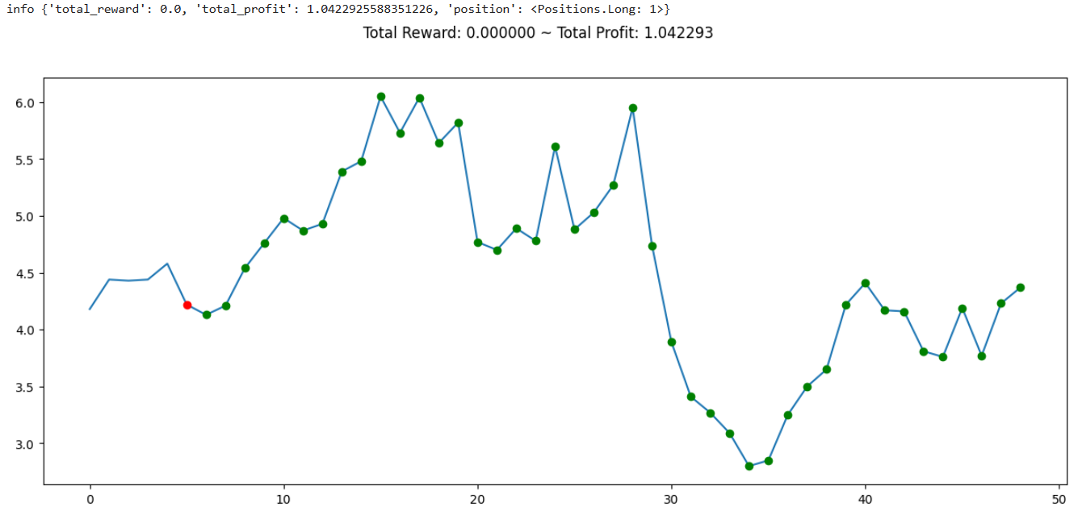
Practical Applications : Trading Bot

Slide 18
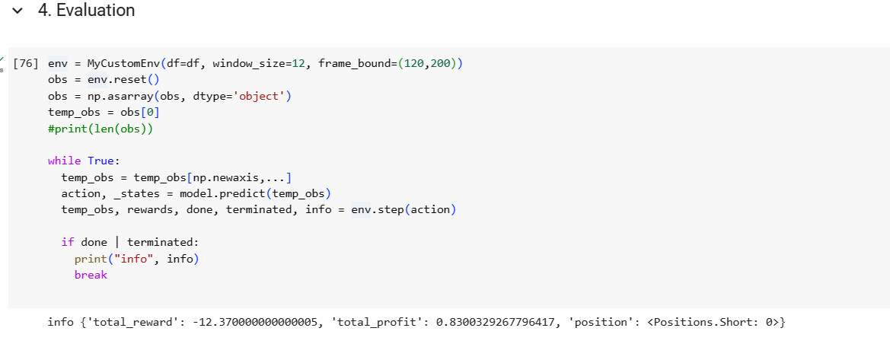
Practical Applications : Improved Trading Bot

Slide 19
Custom Indicators Used
Simple Moving Average (SMA)
Relative Strength Index (RSI)
On Balance Volume(OBV)
Exponential Moving Average(EMA)
Volume Adjusted Moving Average (VAMA)
Market Momentum(MOM)
Volume Price Trend(VPT)
Moving Standard deviation(MSD)

Slide 20
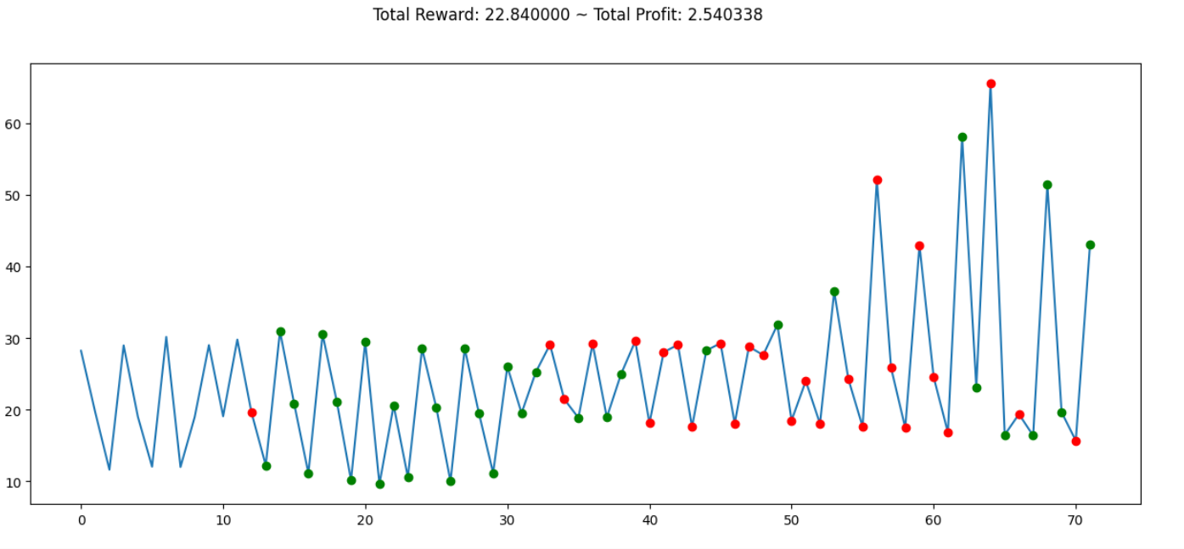
Practical Applications : TRADING BOT

Slide 21

Practical Applications : Space Invaders

Slide 22

Thank You

